Slide 1
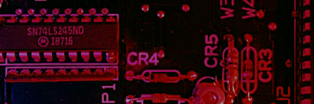
BOOLEAN LOGIC
Binary Logic
Basic
AND
OR
Derived
NAND
NOT
NOR
XOR
XNOR

Slide 2
Summary
A
A
The AND Gate
X
X
B
B
The AND gate produces a HIGH output when all inputs are HIGH; otherwise, the output is LOW. For a 2-input gate, the truth table is
0 0
0 1
1 0
1 1
0
0
0
1
The AND operation is usually shown with a dot between the variables but it may be implied (no dot). Thus, the AND operation is written as X = A .B or X = AB.

Slide 3
Summary
A
A
The AND Gate
X
X
B
B
Example waveforms:
A
B
X
The AND operation is used in computer programming as a selective mask. If you want to retain certain bits of a binary number but reset the other bits to 0, you could set a mask with 1’s in the position of the retained bits.

Slide 4
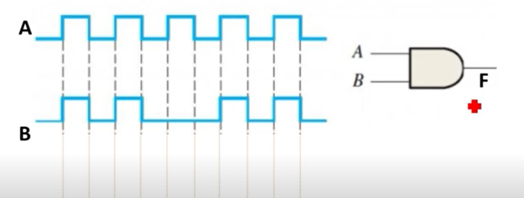
Draw the output diagram of the following circuit
A | B | F
0 | 0 | 0
1 | 1 | 1
0 | 0 | 0
1 | 1 | 1
0 | 0 | 0
1 | 0 | 0
0 | 0 | 0
1 | 1 | 1
0 | 0 | 0
1 | 1 | 1
0 | 0 | 0
0
1
0
0
1
0
1
0
0
1
1
0
0
0
0
0
1
1
1
1

Slide 5
Summary
A
X
A
X
The OR Gate
B
B
The OR gate produces a HIGH output if any input is HIGH; if all inputs are LOW, the output is LOW. For a 2-input gate, the truth table is
0 0
0 1
1 0
1 1
0
1
1
1
The OR operation is shown with a plus sign (+) between the variables. Thus, the OR operation is written as X = A + B.

Slide 6
Summary
The OR Gate
A
X
A
X
B
B
Example waveforms:
A
B
X
The OR operation can be used in computer programming to set certain bits of a binary number to 1.

Slide 7
Summary
A
X
The Inverter
Example waveforms:
A
X
A group of inverters can be used to form the 1’s complement of a binary number:
Binary number
1 0 0 0 1 1 0 1
0 1 1 1 0 0 1 0
1’s complement

Slide 8
Boolean Algebra
Introduction
In 1854 , George Boole Published a work titled An Investigation of Laws of Thought, On which are founded the mathematical theories of logic and probabilities.
It was his publication that a “ logical algebra” Known today as Boolean algebra.
Boolean algebra is a convenient and systematic way of expressing and analyzing the operation of logic circuits.

Slide 9
Summary

Slide 10
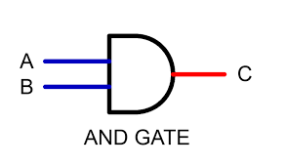
Laws of Boolean Algebra
AND operation
A. 0 = 0
Truth table
A | B | Y
0 | 0 | 0
0 | 1 | 0
1 | 0 | 0
1 | 1 | 1
Y
Y = A B

Slide 11
Laws of Boolean Algebra
AND operation
A. A = A
Truth table
A | B | Y
0 | 0 | 0
0 | 1 | 0
1 | 0 | 0
1 | 1 | 1
Y
Y = A B

Slide 12
Laws of Boolean Algebra
AND operation
A. A = 0
Truth table
A | A’ | Y
0 | 1 | 0
1 | 0 | 0
A
A
Y
Y = A B

Slide 13
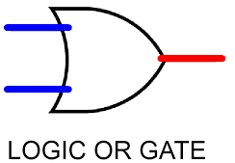
Laws of Boolean Algebra
OR operation
Truth table
A + 1 = 1
A | B | Y
0 | 0 | 0
0 | 1 | 1
1 | 0 | 1
1 | 1 | 1
A
Y = 1
B

Slide 14
Laws of Boolean Algebra
OR operation
A + 0 = A
Truth table
A | B | Y
0 | 0 | 0
0 | 1 | 1
1 | 0 | 1
1 | 1 | 1
A
Y
B

Slide 15
Laws of Boolean Algebra
OR operation
A + A = A
Truth table
A | A | Y
0 | 0 | 0
1 | 1 | 1
A
Y = A
A

Slide 16
Laws of Boolean Algebra
OR operation
A + A = 1
Truth table
A | A’ | Y
0 | 1 | 1
1 | 0 | 1
A
Y = 1
A

Slide 17
Laws of Boolean Algebra
Commutative Law
This law states that the order in which the variable are Ored makes no different
A+ B = B + A
A. B = B. A
A
B
B
Y
Y
A
B
A

Slide 18
Laws of Boolean Algebra
Associative Law
This law allows the removal of brackets from an expression and regrouping of the variables
A+ (B + C ) = (A + B ) + C
A | B | C | B+C | A+(B+C)
0 | 0 | 0 | 0 | 0
0 | 0 | 1 | 1 | 1
0 | 1 | 0 | 1 | 1
0 | 1 | 1 | 1 | 1
1 | 0 | 0 | 0 | 1
1 | 0 | 1 | 1 | 1
1 | 1 | 0 | 1 | 1
1 | 1 | 1 | 1 | 1
A | B | C | A+B | (A+B)+C
0 | 0 | 0 | 0 | 0
0 | 0 | 1 | 0 | 1
0 | 1 | 0 | 1 | 1
0 | 1 | 1 | 1 | 1
1 | 0 | 0 | 1 | 1
1 | 0 | 1 | 1 | 1
1 | 1 | 0 | 1 | 1
1 | 1 | 1 | 1 | 1
1 , if any input positive

Slide 19
Laws of Boolean Algebra
Associative Law
This law allows the removal of brackets from an expression and regrouping of the variables.
A (B C ) = (A B ) C
A | B | C | BC | A (BC)
0 | 0 | 0 | 0 | 0
0 | 0 | 1 | 0 | 0
0 | 1 | 0 | 0 | 0
0 | 1 | 1 | 1 | 0
1 | 0 | 0 | 0 | 0
1 | 0 | 1 | 0 | 0
1 | 1 | 0 | 0 | 0
1 | 1 | 1 | 1 | 1
A | B | C | A B | (AB)C
0 | 0 | 0 | 0 | 0
0 | 0 | 1 | 0 | 0
0 | 1 | 0 | 0 | 0
0 | 1 | 1 | 0 | 0
1 | 0 | 0 | 0 | 0
1 | 0 | 1 | 0 | 0
1 | 1 | 0 | 1 | 0
1 | 1 | 1 | 1 | 1
1 ,in both

